Slide 1

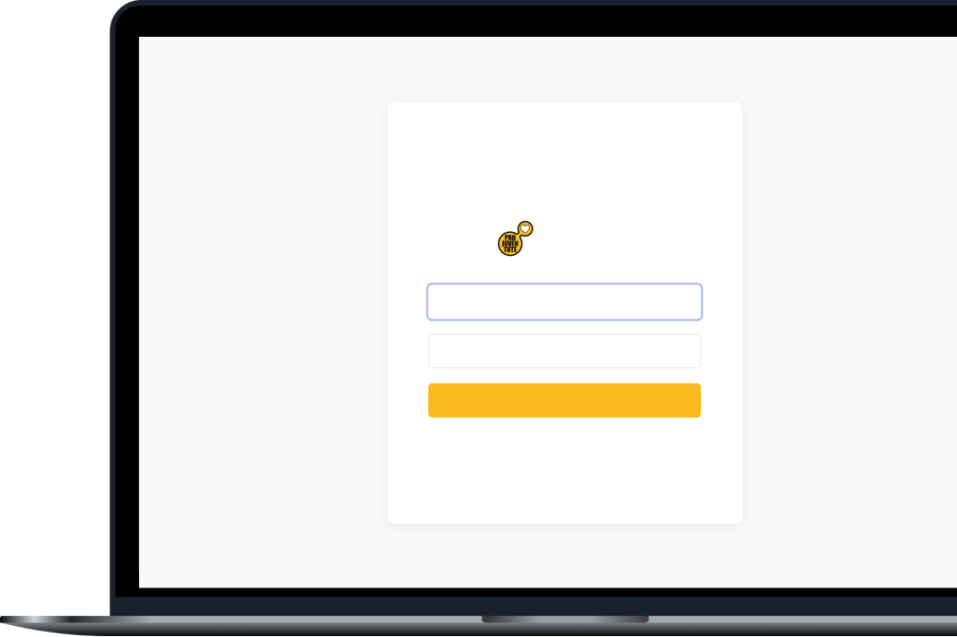
Team name
Contact
Date
KPI-Crackers
lukasz@bartkiewicz.com.pl
4.11.2023
KPI Monitor
&
KPI-Crackers
Email
KPI Monitor
Password
Sign In

Slide 2

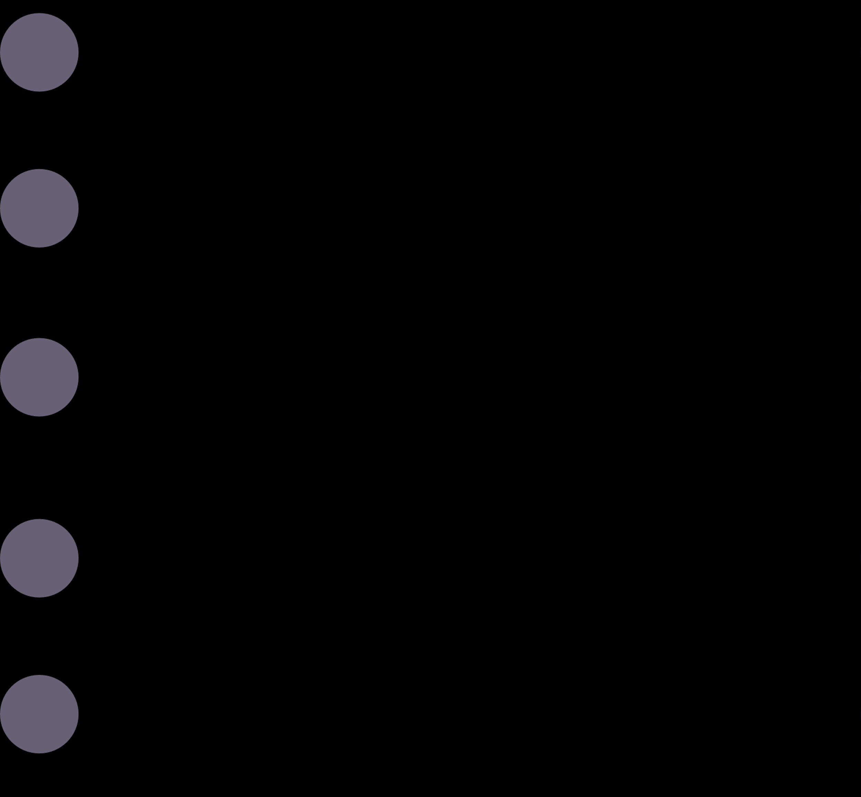
Pro Juventute’s challenges & our objectives
01
02
Walkthrough
Presentation Overview
03
Our solution – KPI Monitor
Our learnings & our team
04
05
Q&A

Slide 3
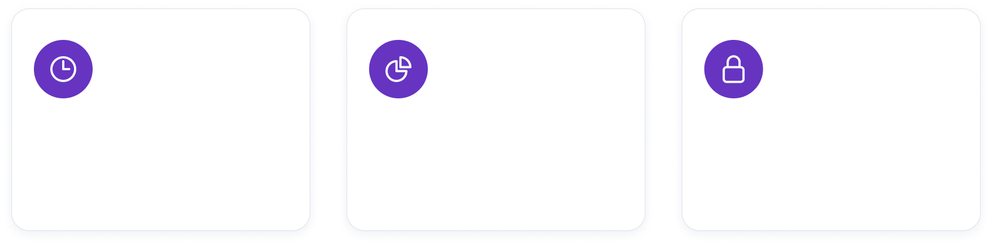
Pro Juvenute’s challenges
Time consuming data tracking that lacks consistency.
Time consuming
Data quality
Lack of transparency
Processes are not efficient
Lack of consistency and errors
Who did what and when?
Notes:
Challenges Picture Pro Juventute’s situation: Manual tracking of KPIs are occupying the employees valuable time. The reporting processes are not reflecting Pro Juventutes potential. Because
Time consuming. It is time consuming to work with multiple software that are not made to work seamlessly together.
Data quality: is inconsistent cause mistakes can happen easily. Additionally data validation is not implemented. .
Lack of transparency: Pro Juventute’s tools don’t allow them to see who has changed something. The economist who made a change is not enabled to give context to the change easily.

Slide 4
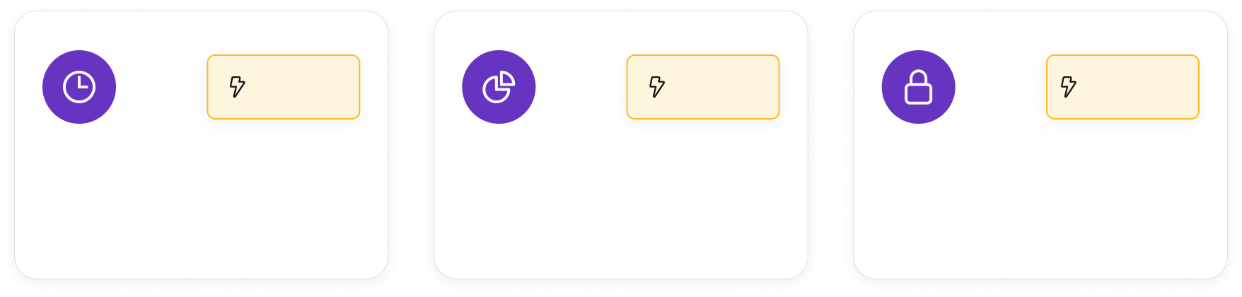
Our Objectives
The solutions that help Pro Juventute reach their full potential.
Time consuming
Data Quality
Lack of transparency
Efficient KPI Processing
Standardized Data Entry Solution
Provide Log History​
Notes:
Objectives
To solve the challenges we had a few guiding objectives. These are crucial solutions that will help Pro Juventute to reach their full potential.
Efficient KPI tracking: From now on all elements work together seamlessly. This allows the economists to focus on more important tasks.
Standardized data entry solution: Standards help to make sure all entered values are valid and they use the correct formulas. We’ll just demo that in a minute to explain more.
Log history for transparency : This helps to trace changes. But more importantly the logs are designed to also allow for dialogue digitally.

Slide 5

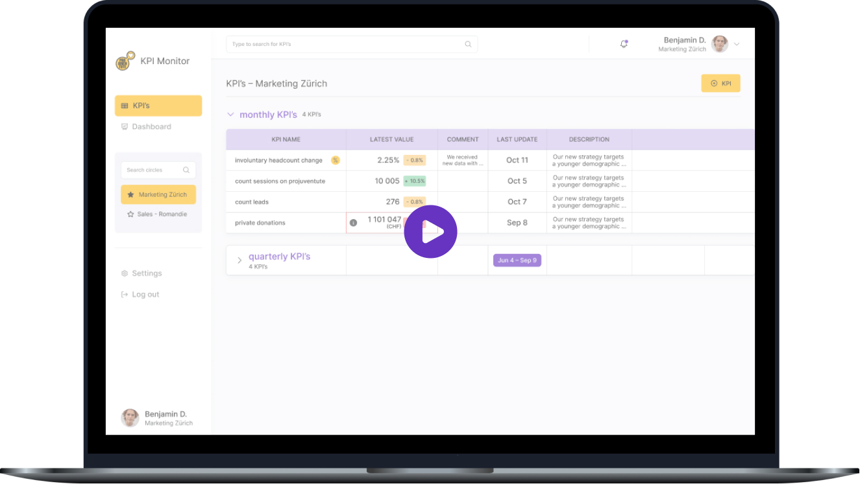
Walkthrough
Journey of an economist with our KPI Monitor

Slide 6
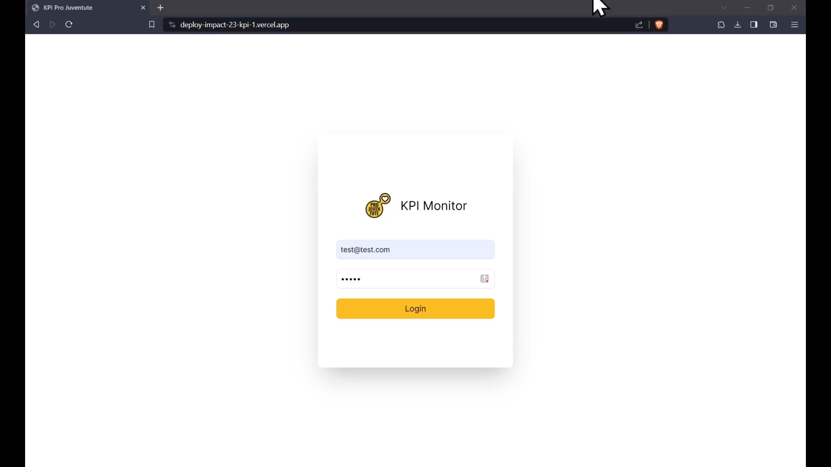

Slide 7
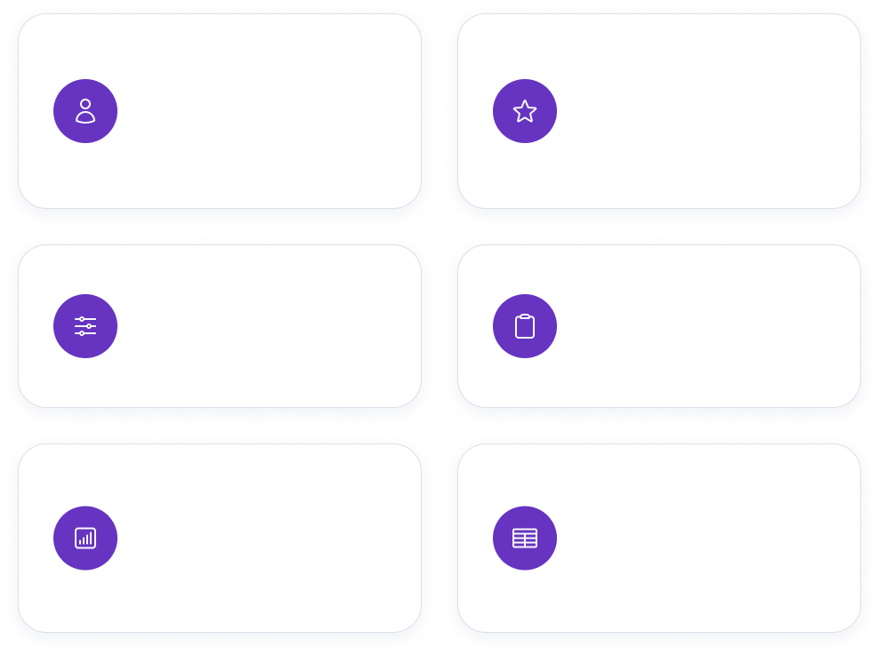
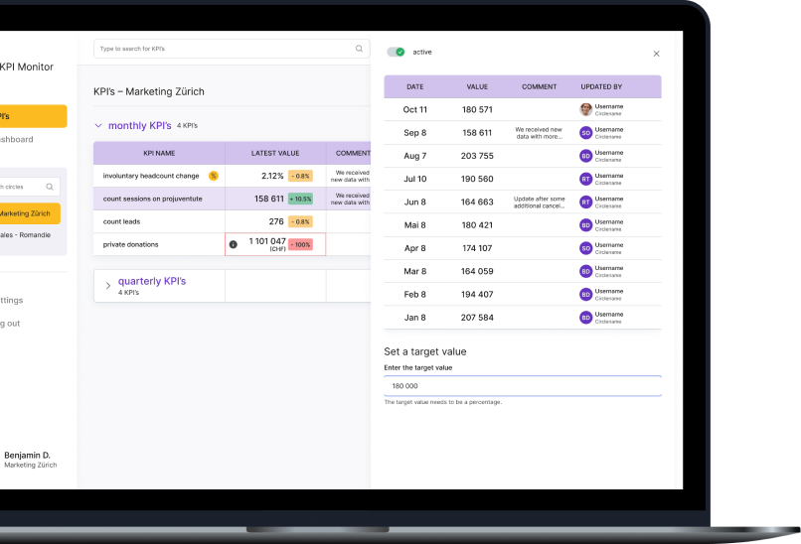
KPI Monitor
Favourite circles
User login
Special features
KPI templates
Audit log
Insights and visualizations
Standardized data entry

Slide 8
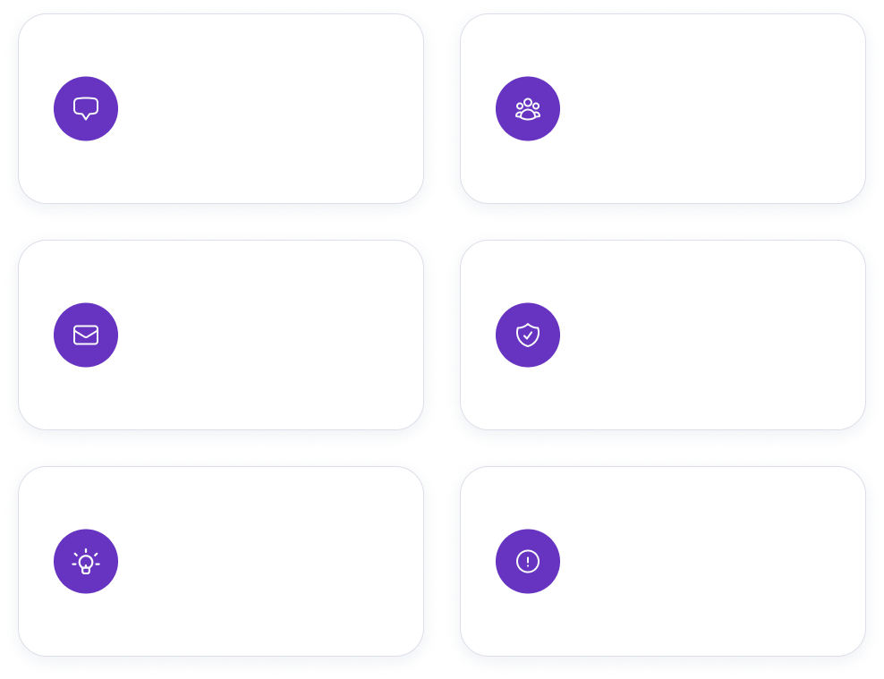
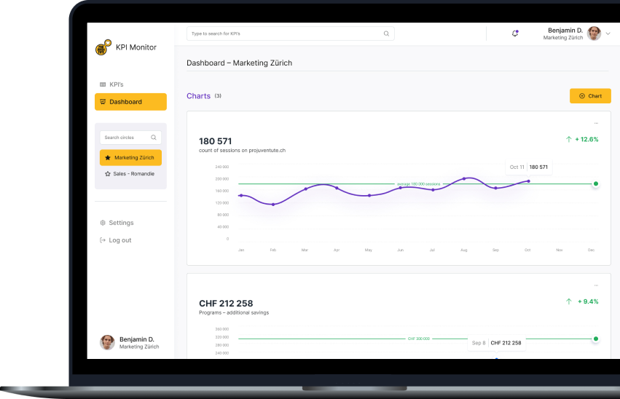
KPI Monitor 2.0
Language inclusivity
User management
Email notifications
Enhanced data privacy
Predictive analysis
Anomaly detection

Slide 9

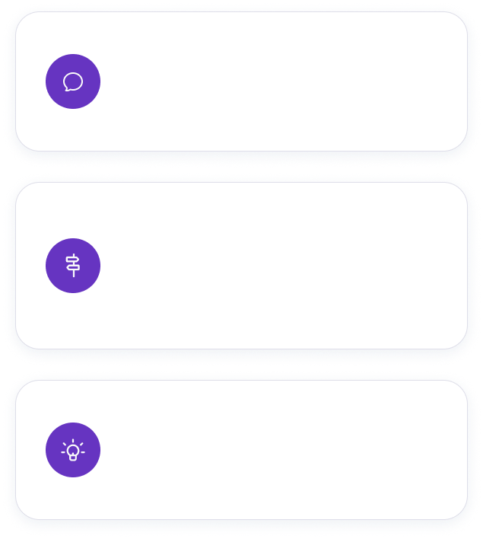
Team cohesion
Our learnings
Decision making
Tools and technologies

Slide 10

Our team
Daniel Czosnek
Aurelie Pham
Giang Pham
Simona Miljanovic
KPI-Crackers
Fullstack Lead/Backend
Fullstack Deputy
Frontend Deputy
UX/UI Designer
Jasmin Sert
Cara Finlay
Lukasz Bartkiewicz
Waithira Mirie
Data Science Lead
Data Science Deputy
Project Manager
Scrum Master

Slide 11


Q&A
It’s your turn to ask questions and let us know about your point of view.
?!

Slide 12
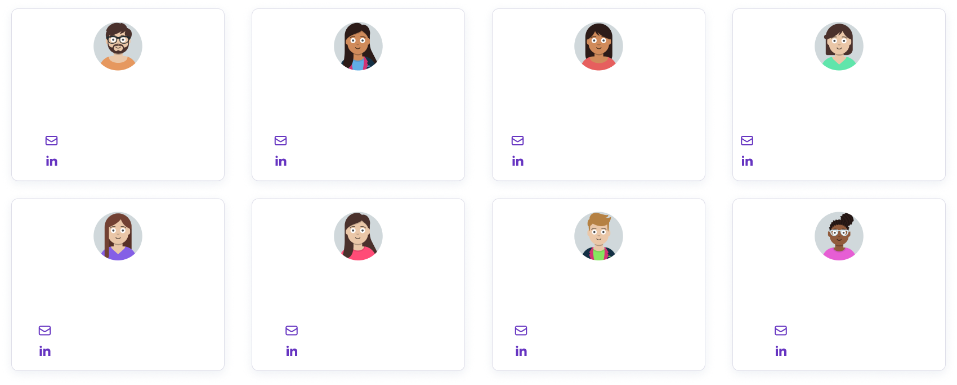

Team name
Contact
Date
KPI-Crackers
lukasz@bartkiewicz.com.pl
4.11.2023
Fullstack Lead/Backend
Fullstack Deputy
Frontend Deputy
UX/UI Designer
Daniel Czosnek
Aurelie Pham
Giang Pham
Simona Miljanovic
daczosnek@gmail.com
aurelie.pham@outlook.com
giang.pham1610@gmail.com
simona.miljanovic85@gmail.com
Daniel Czosnek
Aurelie Pham
Giang Pham
Simona Miljanovic
Data Science Lead
Data Science Deputy
Project Manager
Scrum Master
Jasmin Sert
Cara Finlay
Lukasz Bartkiewicz
Waithira Mirie
jasmin_sert@hotmail.com
caracfinlay@gmail.com
lukasz@bartkiewicz.com.pl
waithira.mirie@gmail.com
Jasmin Sert
Cara Finlay
Lukasz Bartkiewicz
Waithira Mirie

